Slide 1
Database Management System Project
Online Shop Management
“Tech-Zone”

Slide 2
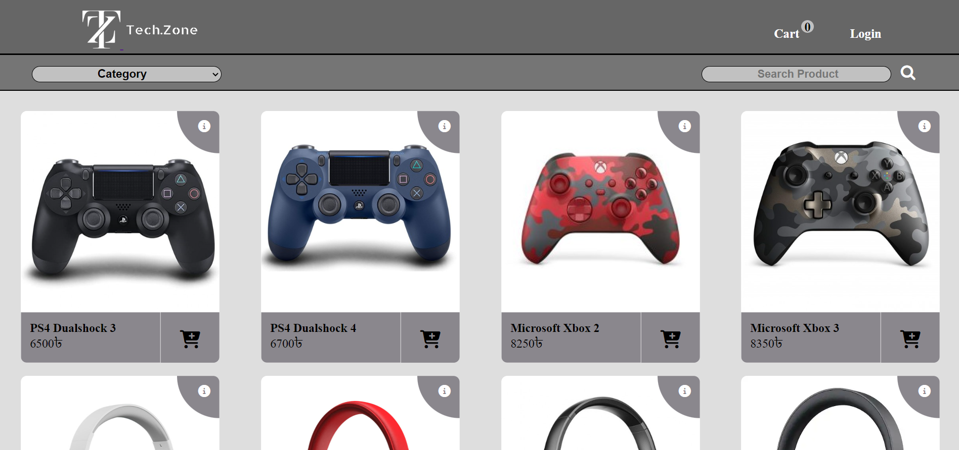
Index Page

Slide 3
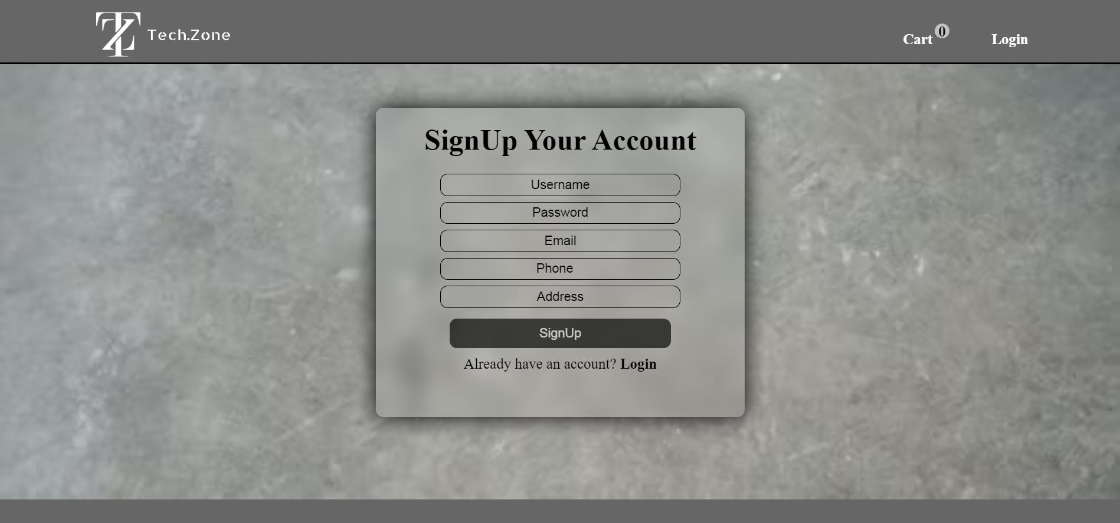
Signup Page

Slide 4
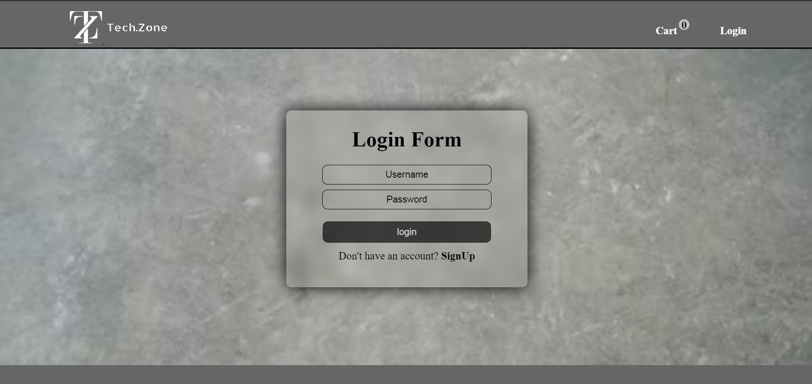
Login Page

Slide 5
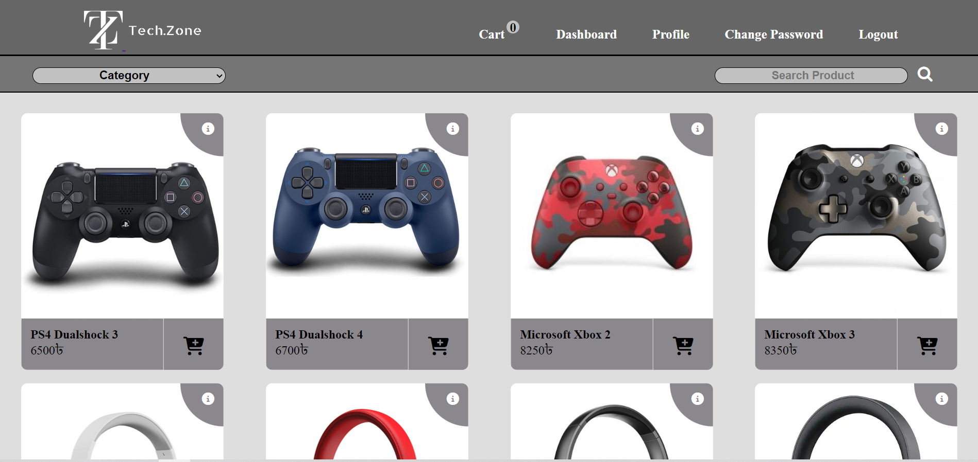
Customer Home Page

Slide 6
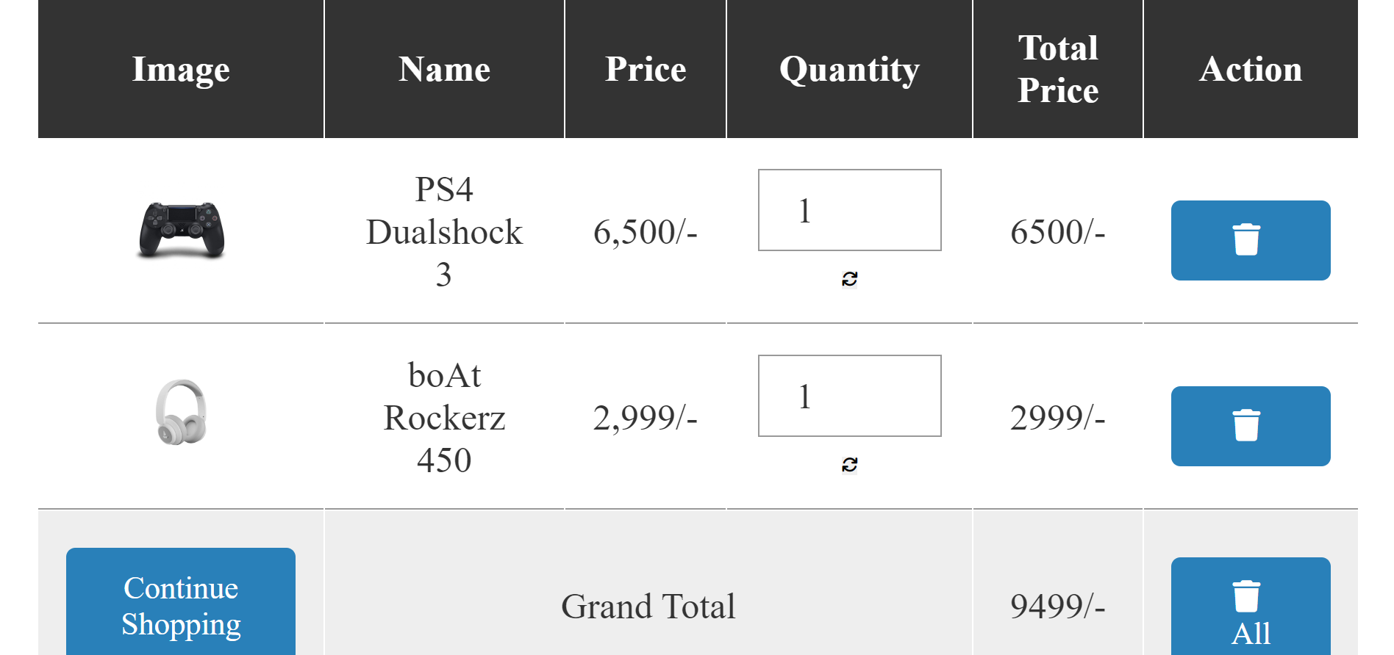
Customer Cart

Slide 7
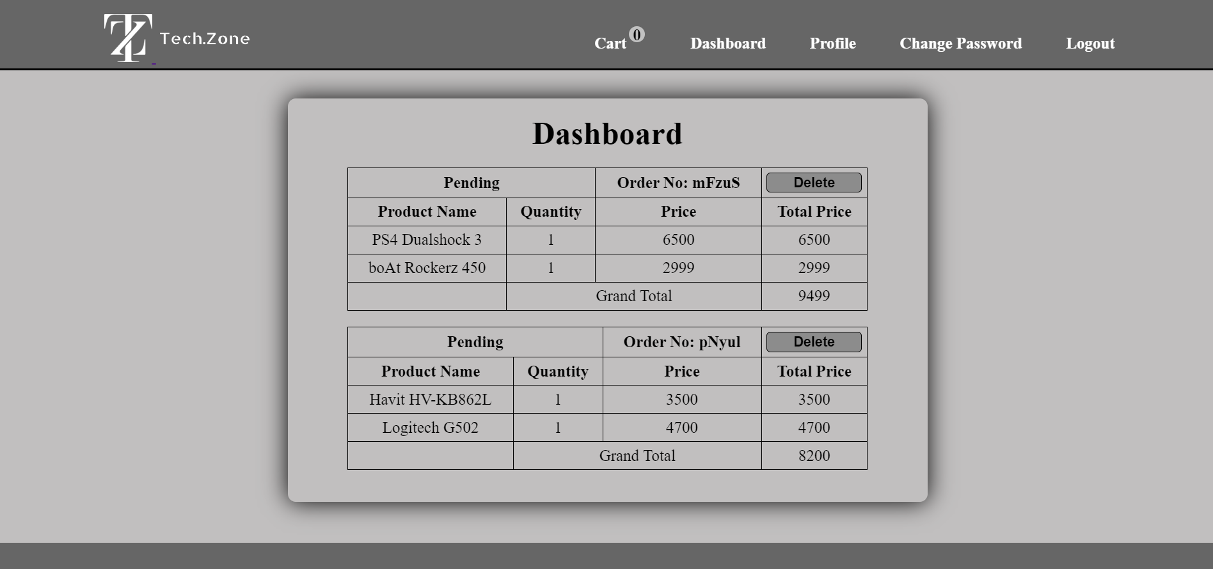
Customer Dashboard (Before)

Slide 8
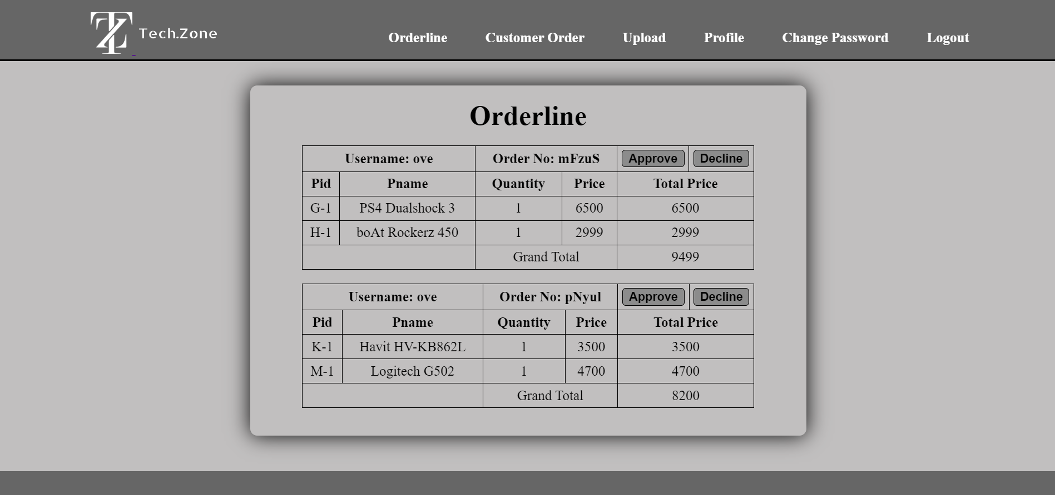
Admin Orderline

Slide 9
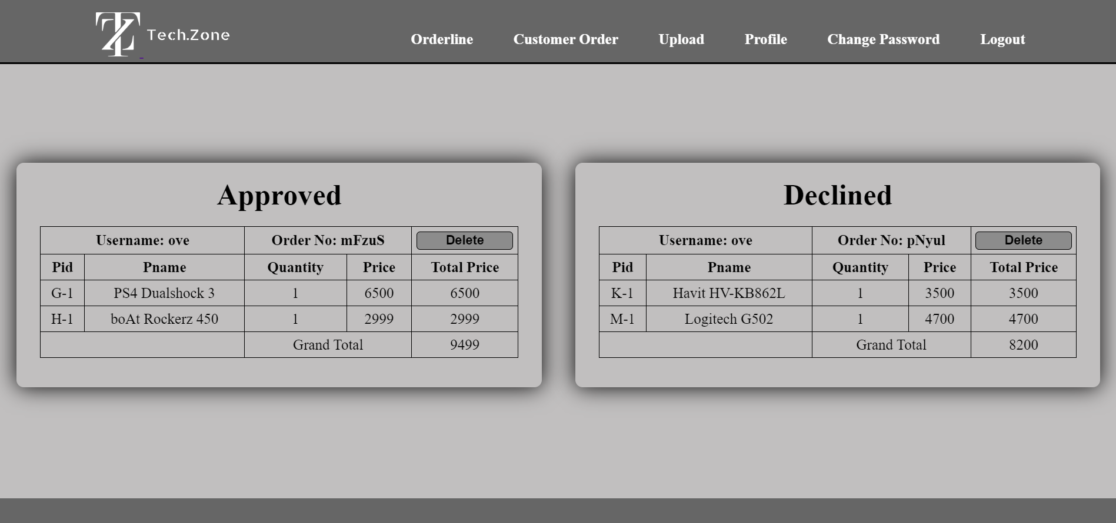
Customer Order Record

Slide 10
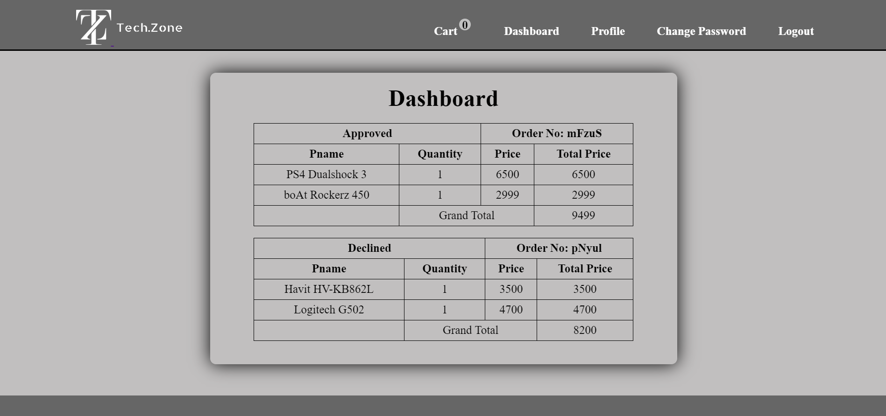
Customer Dashboard (After)

Slide 11
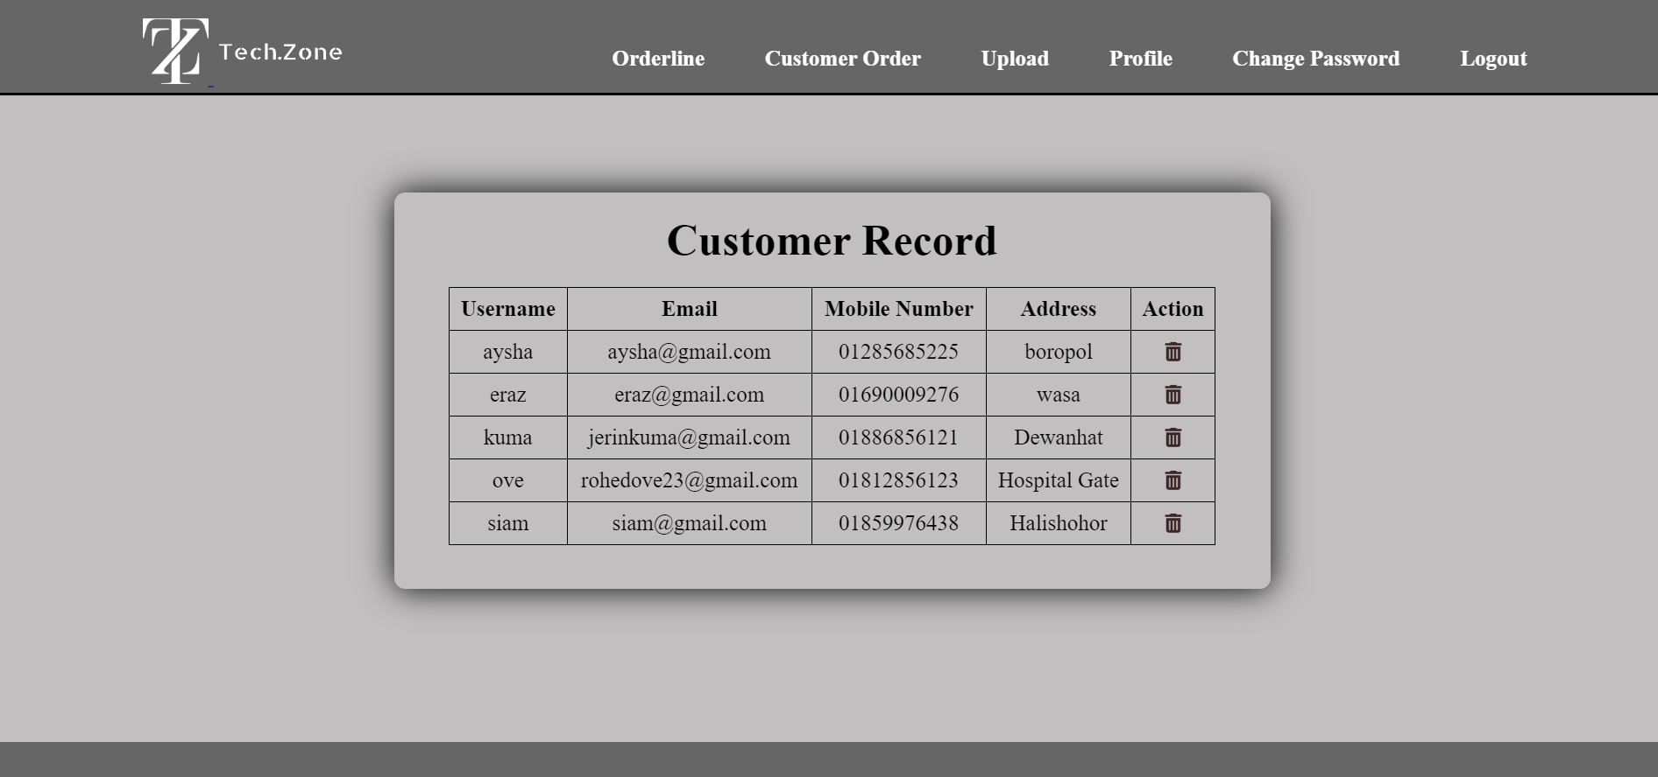
Customer Record

Slide 12
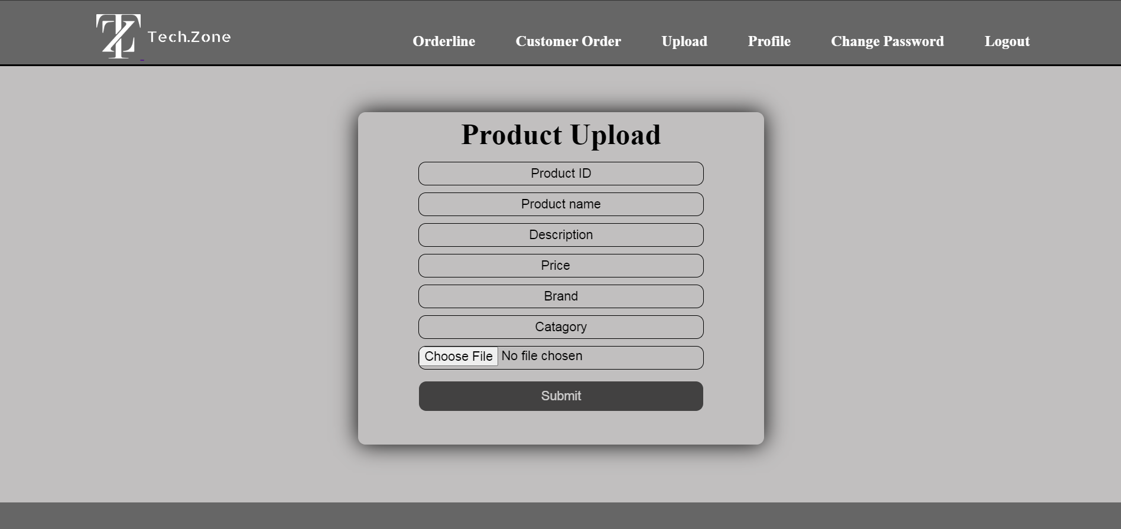
Admin Product Upload

Slide 13
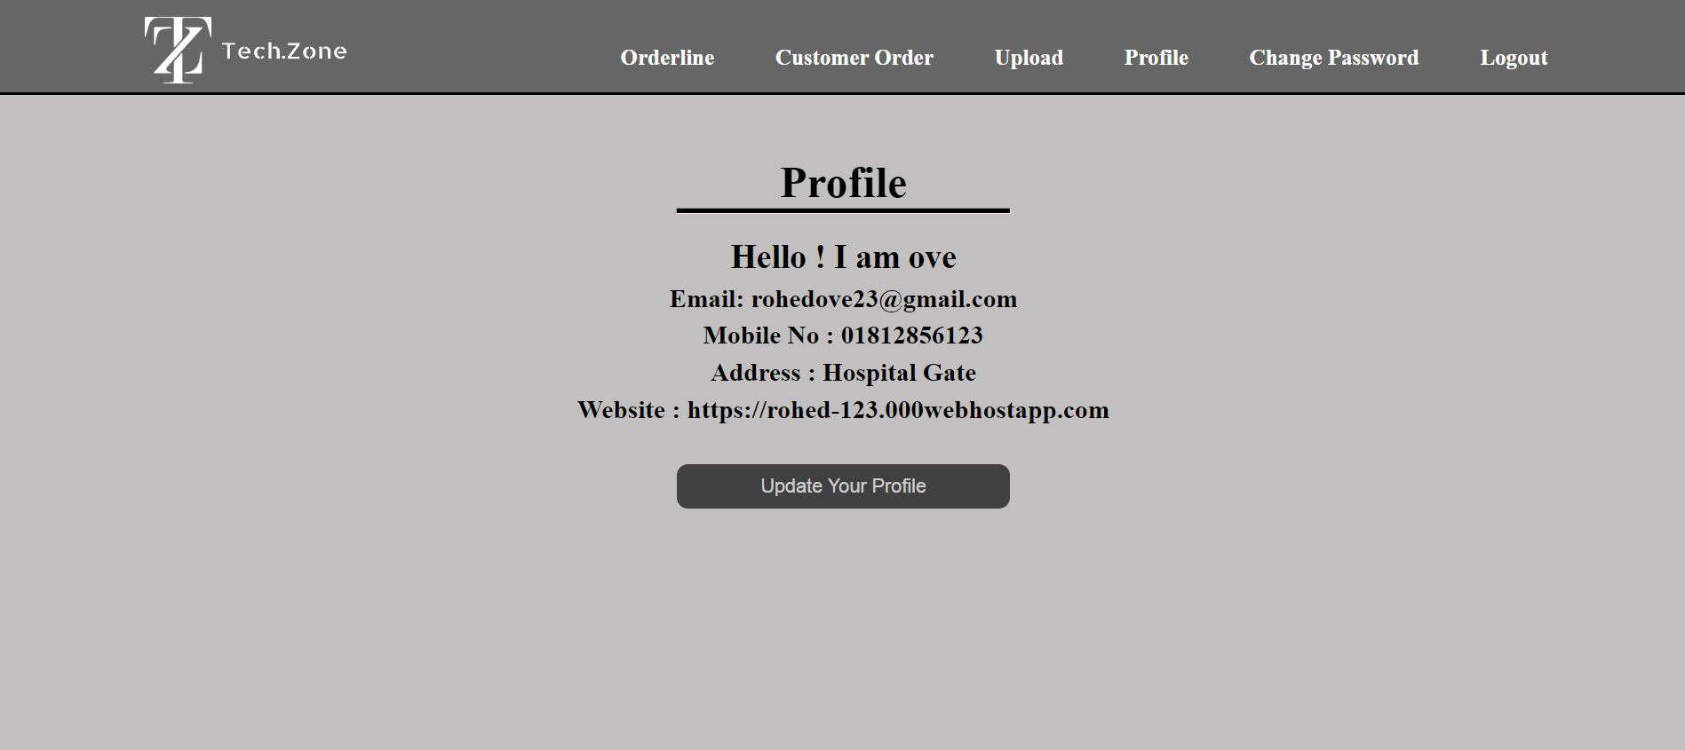
Profile

Slide 14
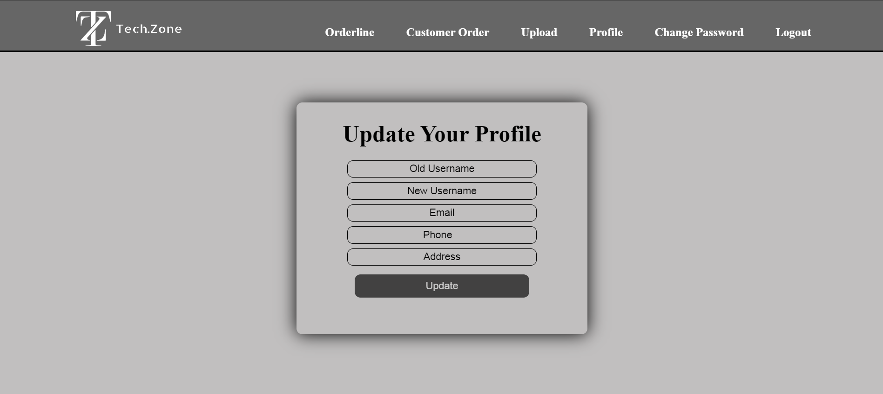
Update Profile

Slide 15
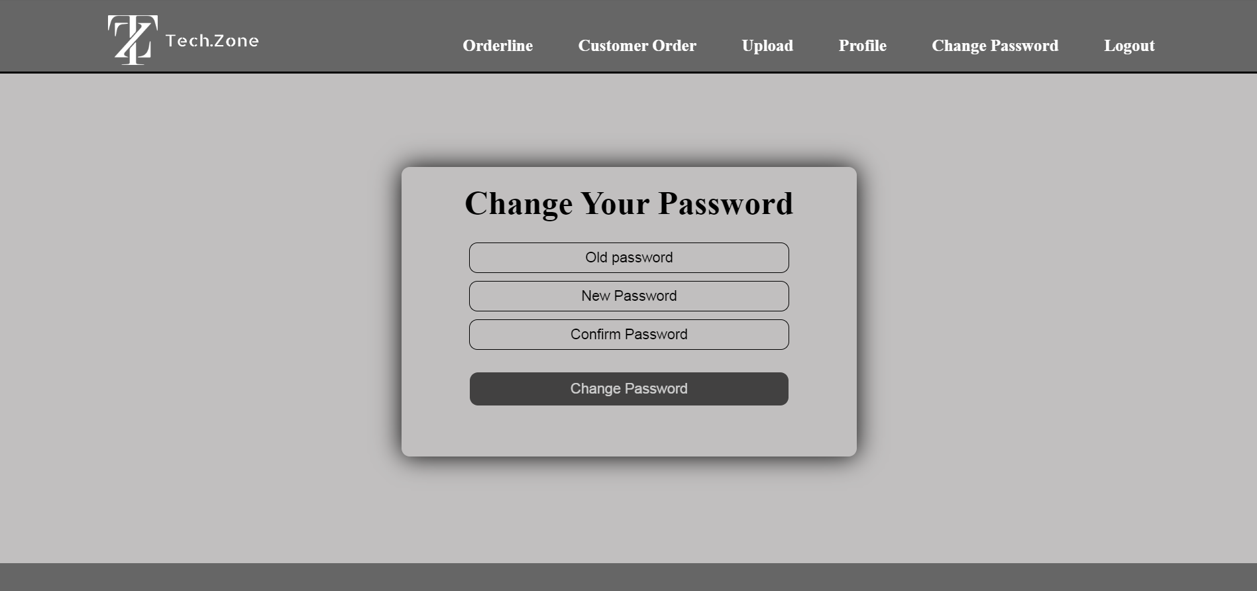
Update Password

Slide 16
Thank You

